Slide 1
Optimizing Your Work with Microsoft 365

Slide 2

Marcelo Flores Vieira
Pursuit Lead – Industry Solution Microsoft

Slide 3






In this course:
Outlook
OneNote
PowerPoint
Word
Microsoft Teams
Excel

Slide 4
Optimizing Your Work with Microsoft 365

Slide 5
Organizing Your Email

Slide 6
In this lesson:
Organizing an Outlook email inbox

Slide 7
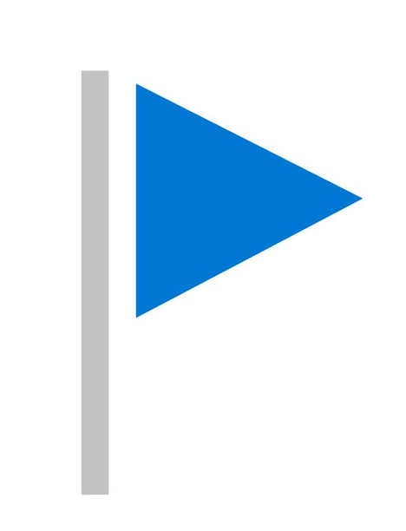
Flags
Help you label the importance of an email

Slide 8
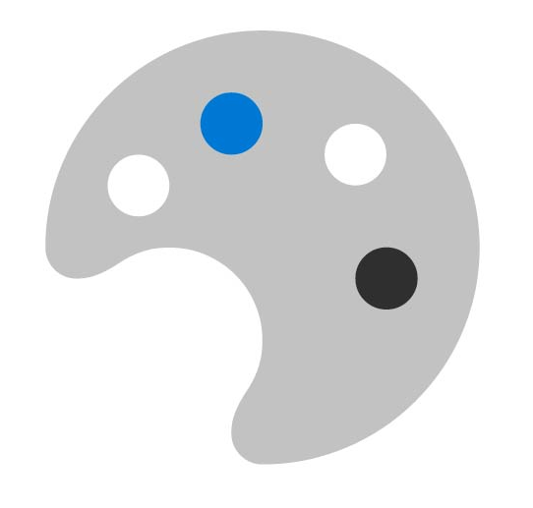
Color
Helps you identify and group associated items

Slide 9
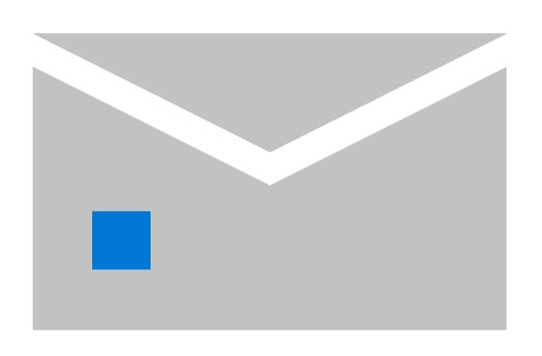
Autoreply
Help you respond to emails when you are away from your inbox

Slide 10
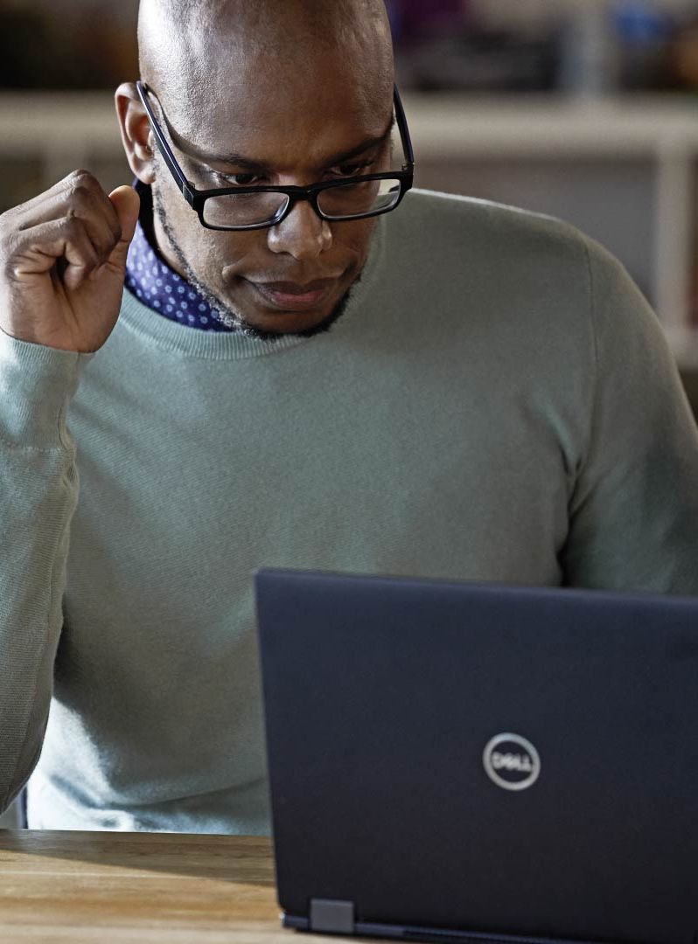

Organize your email
Stay focused
Prioritize tasks
Save time

Slide 11
Managing Contacts and Folders

Slide 12
In this lesson:
Optimizing your Outlook inbox

Slide 13
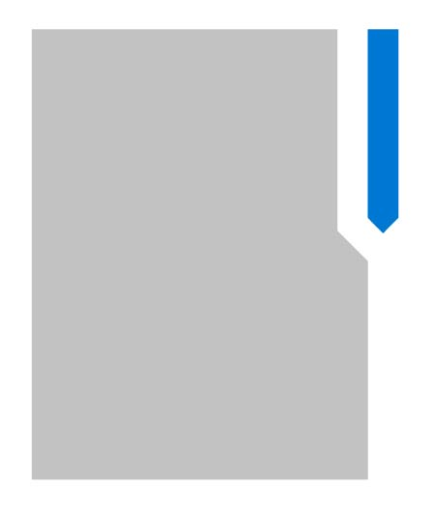
Folders
Help bring structure to your inbox and store relevant information

Slide 14
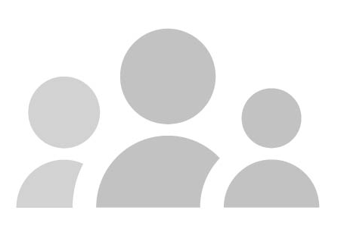
Contact lists
A collection of email addresses that can be used to send to group emails

Slide 15
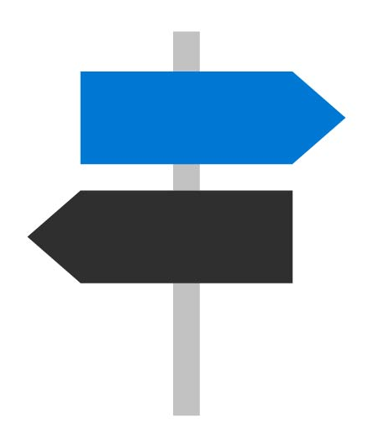
Rules
Help you move and respond to emails automatically

Slide 16
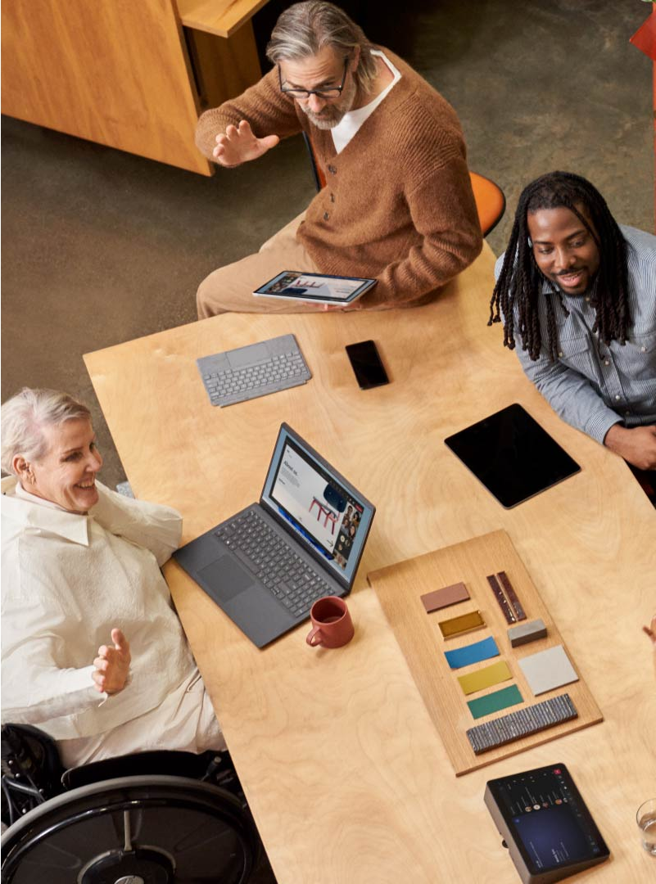
Optimize your Outlook inbox
Manage folders
Build contact lists
Create rules

Slide 17
Organizing To Dos

Slide 18
In this lesson:
Using To Do in Outlook

Slide 19



Slide 20
Use Microsoft To Do in Outlook
Organize tasks
Set reminders

Slide 21
Creating Powerful Meetings

Slide 22
In this lesson:
Scheduling meetings and managing attendees

Slide 23
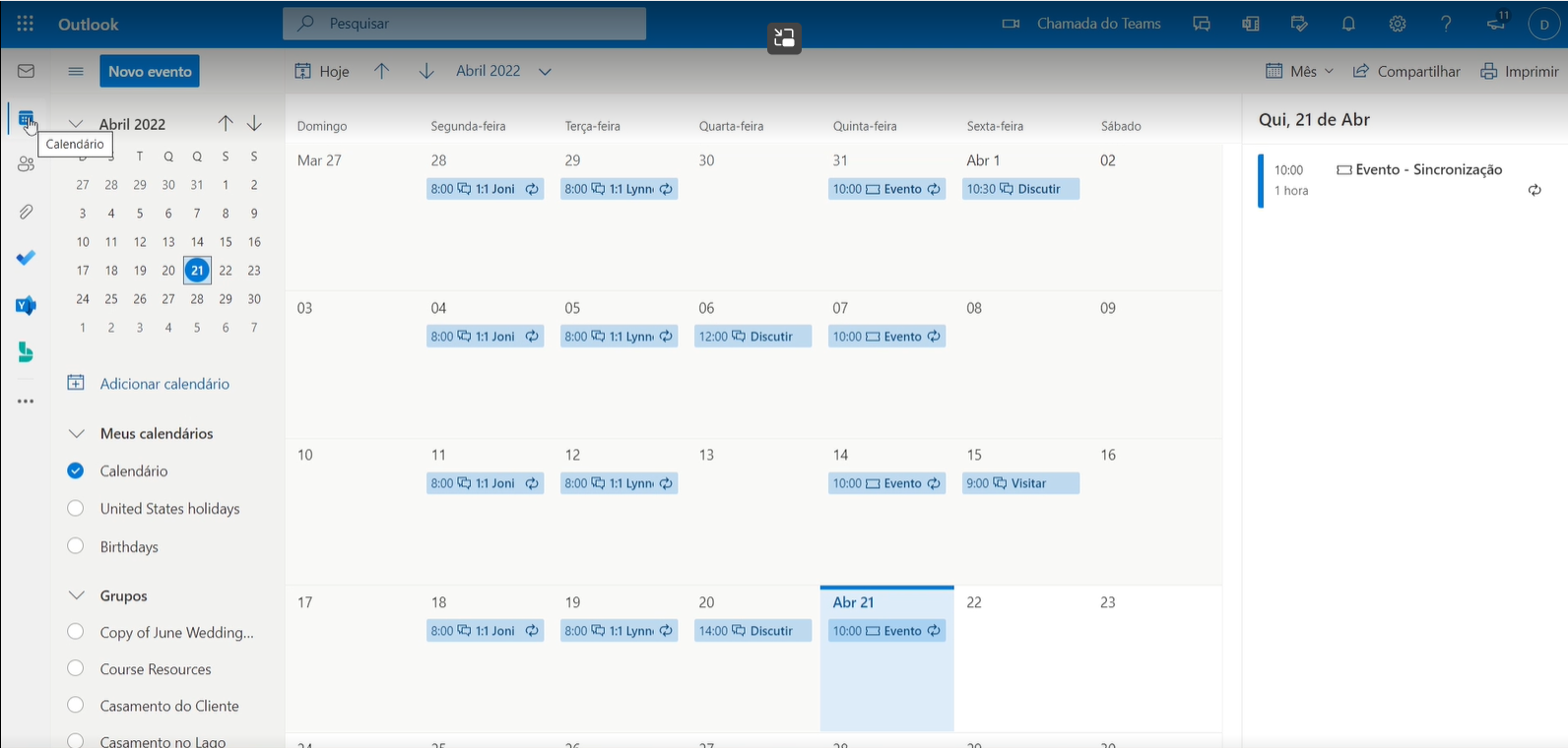
Visibility feature available only for people in your organization.

Slide 24
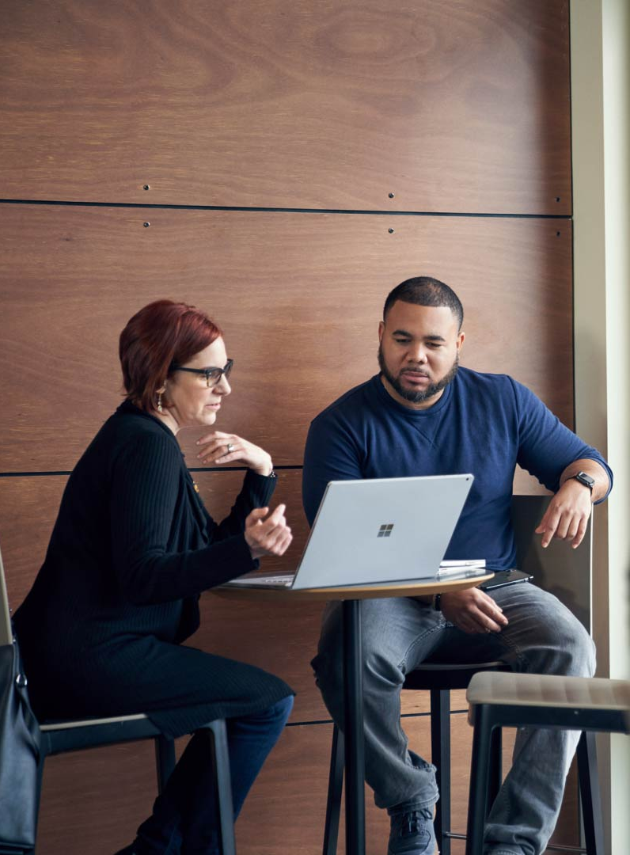
Create meetings in Outlook
Add attendees
Use the scheduling assistant

Slide 25
Managing and Organizing Notebooks

Slide 26
In this lesson:
Organizing notes

Slide 27
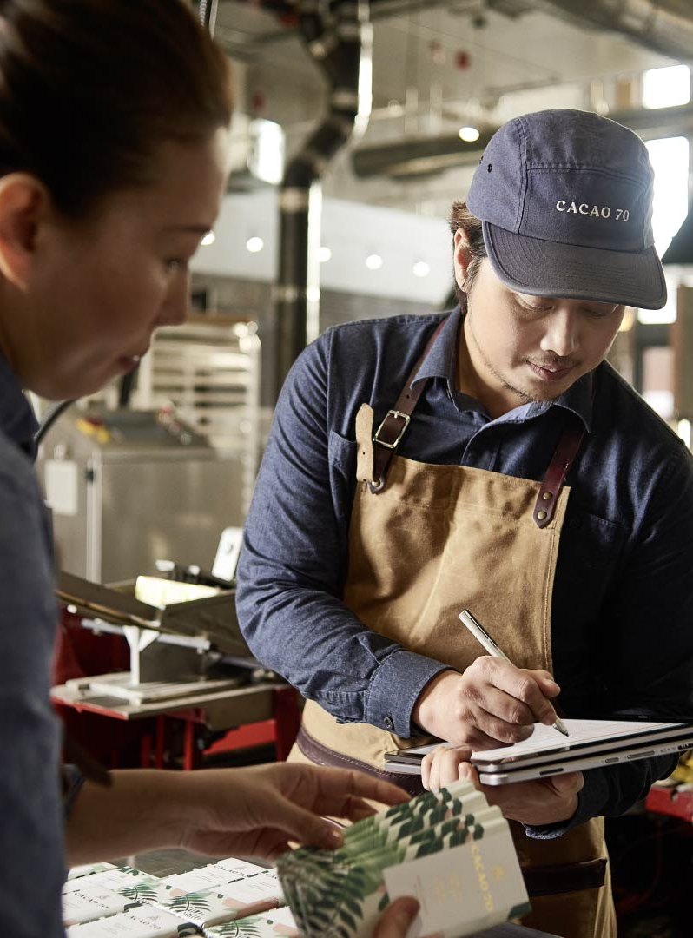
Organize your notes
Build subpages
Add tags

Slide 28
Making the Most of OneNote

Slide 29
In this lesson:
Creating a dynamic, interactive notebook

Slide 30
Create an interactive notebook
Add pictures
Add attachments
Insert videos
Build tables

Slide 31
Collaborate and Share

Slide 32
In this lesson:
Managing and distributing notes

Slide 33

Collaboration and share in OneNote
Manage access
Collaborate on notes

Slide 34
Creating a Presentation

Slide 35
In this lesson:
Building a presentation with formatting tools and design elements

Slide 36
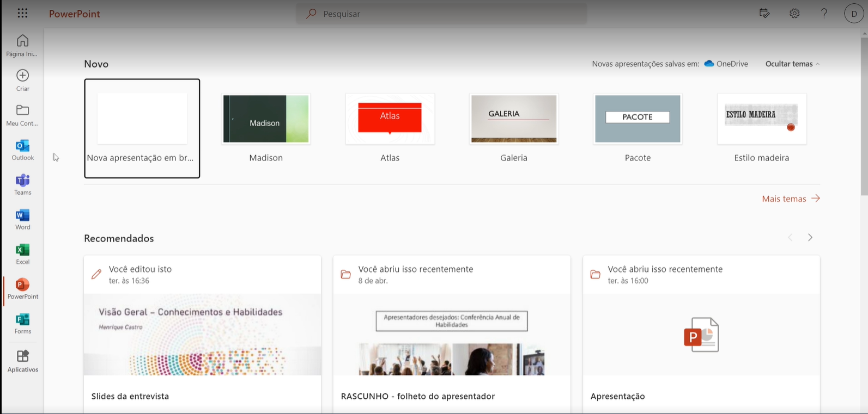
Exercise Files > Customer Event Example Draft 1.pptx

Slide 37
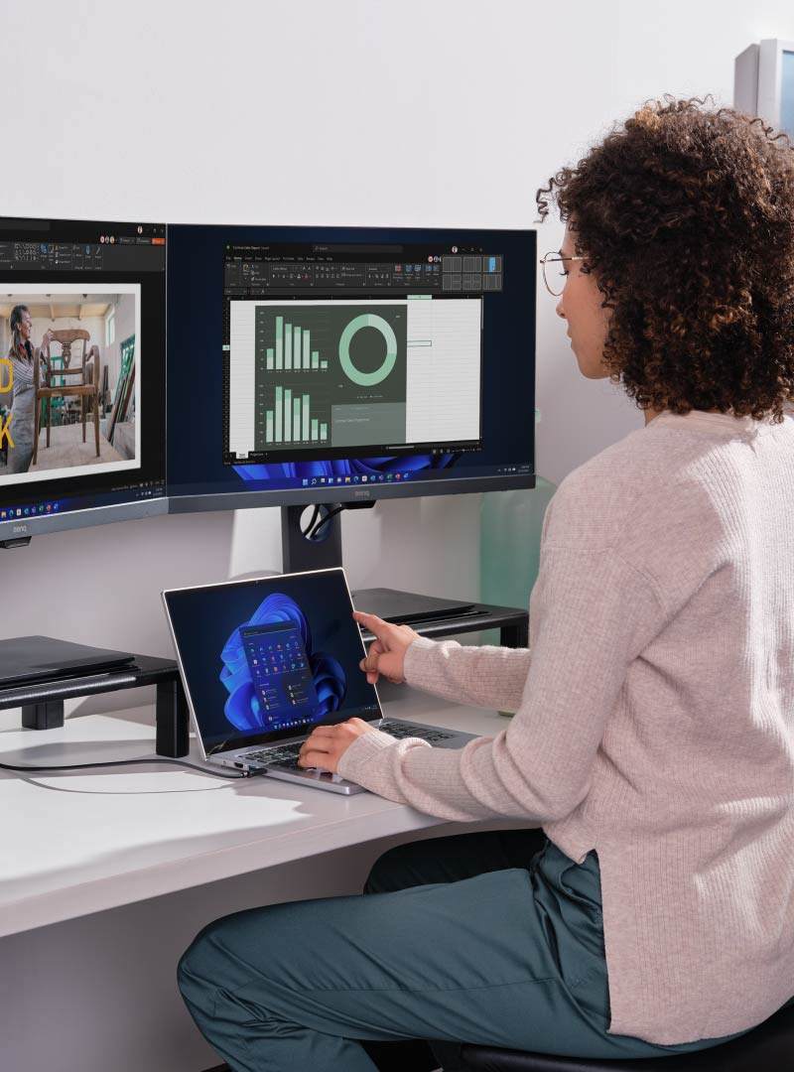
Create your own PowerPoint
Explore design themes
Adjust slide backgrounds
Use PowerPoint Designer

Slide 38
Making Presentations Pop

Slide 39
In this lesson:
Using vibrant designs in PowerPoint to convey key points

Slide 40
Exercise Files > Customer Event Example Draft 2.pptx

Slide 41
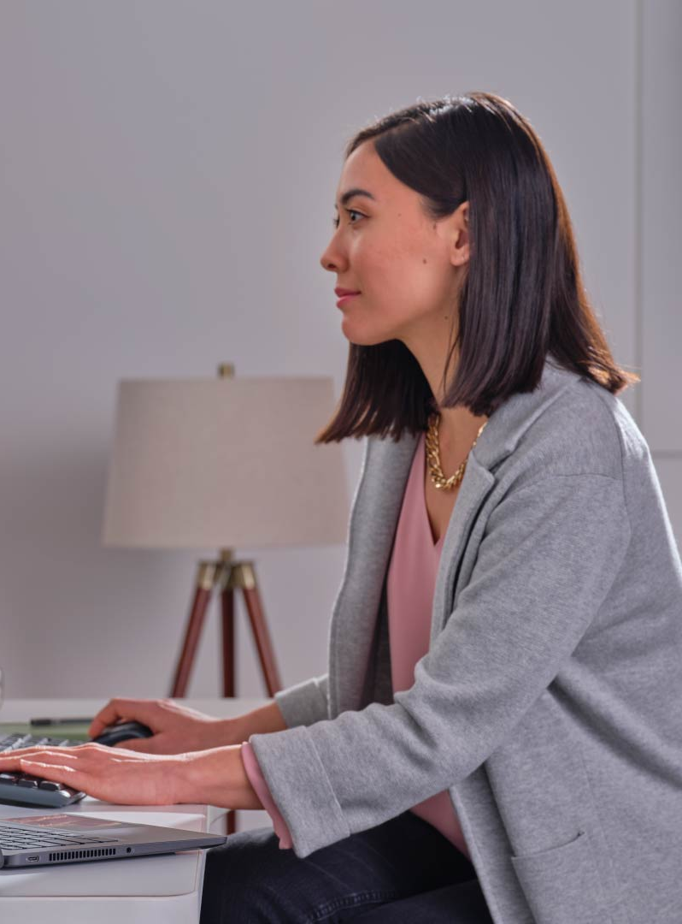
Make your presentations pop
Add images
Add videos
Use SmartArt graphics

Slide 42
Adding Motion to Presentations

Slide 43
In this lesson:
Applying animations and transitions

Slide 44
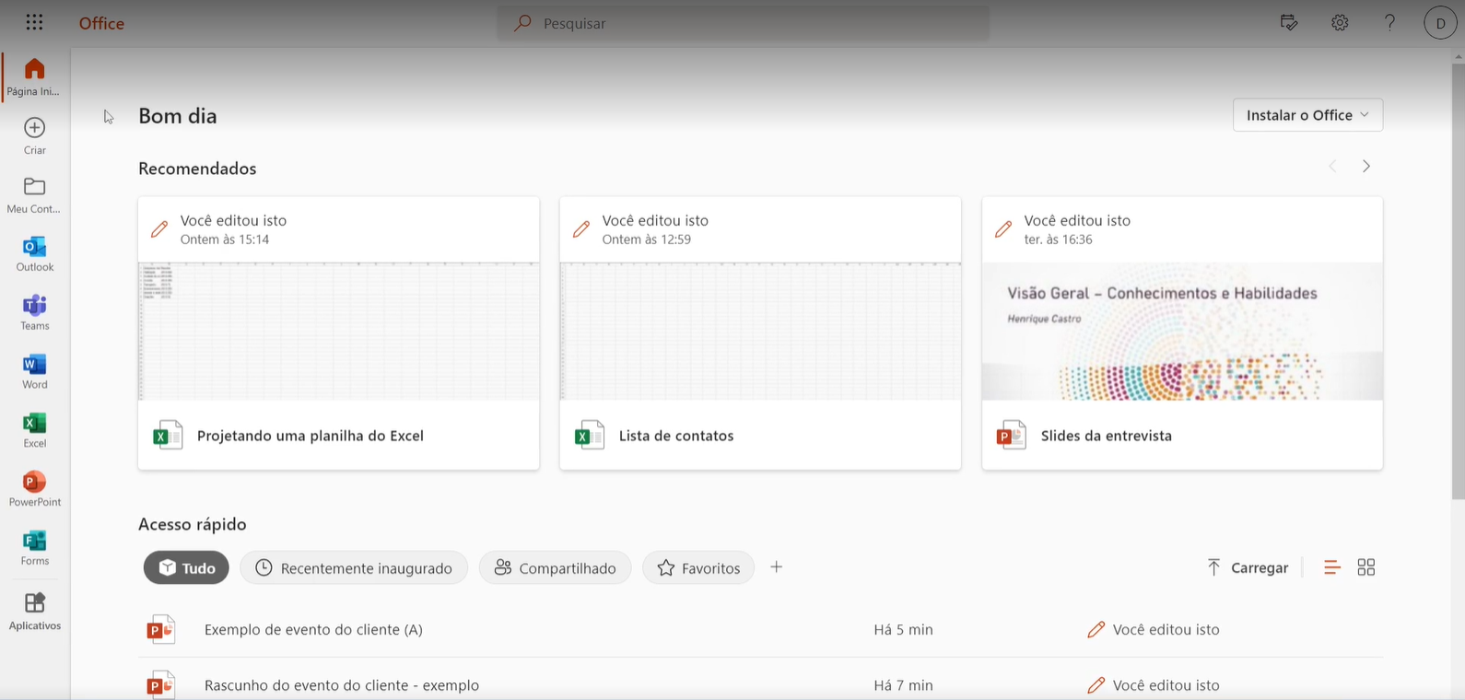
Exercise Files > Customer Event Example (A).pptx

Slide 45

Add motion to presentations
Include transitions
Build animations

Slide 46
Adding Data to Presentations

Slide 47
In this lesson:
Adding charts, tables, and flow charts

Slide 48
Charts
Communicate data graphically

Slide 49
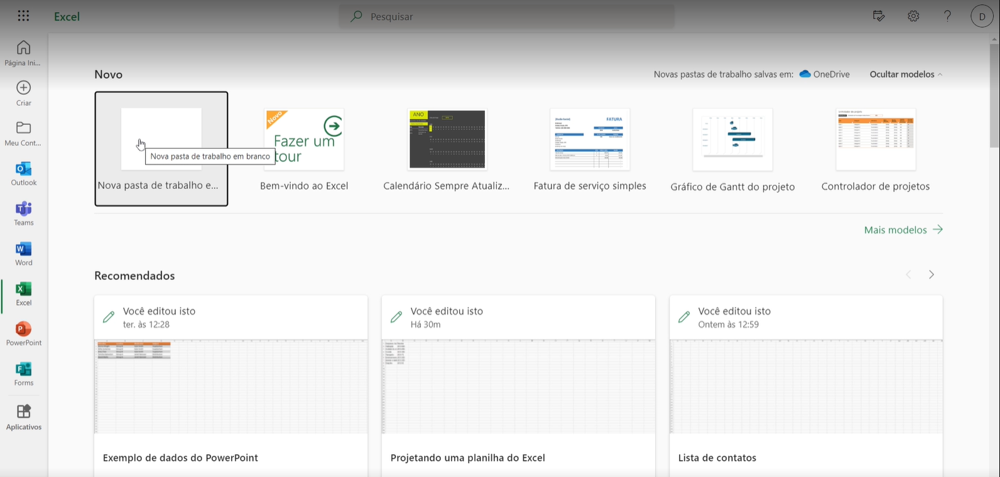
Exercise Files > Example PowerPoint Data.xlsx

Slide 50
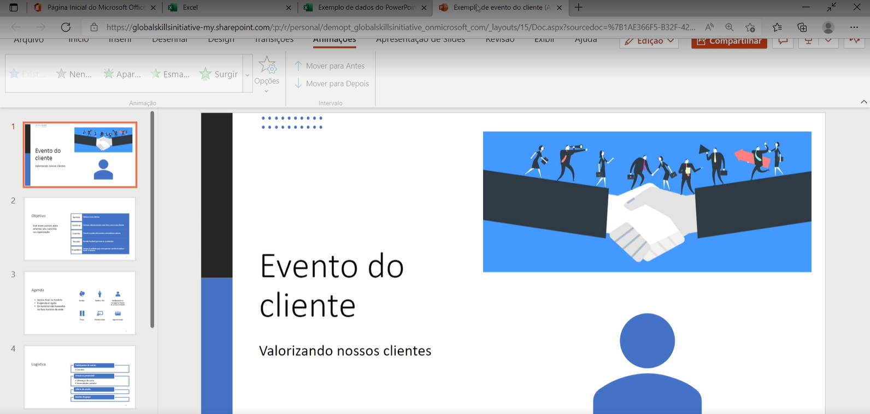
Exercise Files > Customer Event Example (A).pptx

Slide 51
Tables
Help manage and analyze groups of related data

Slide 52
Flowcharts
A diagram that show a process or workflow

Slide 53
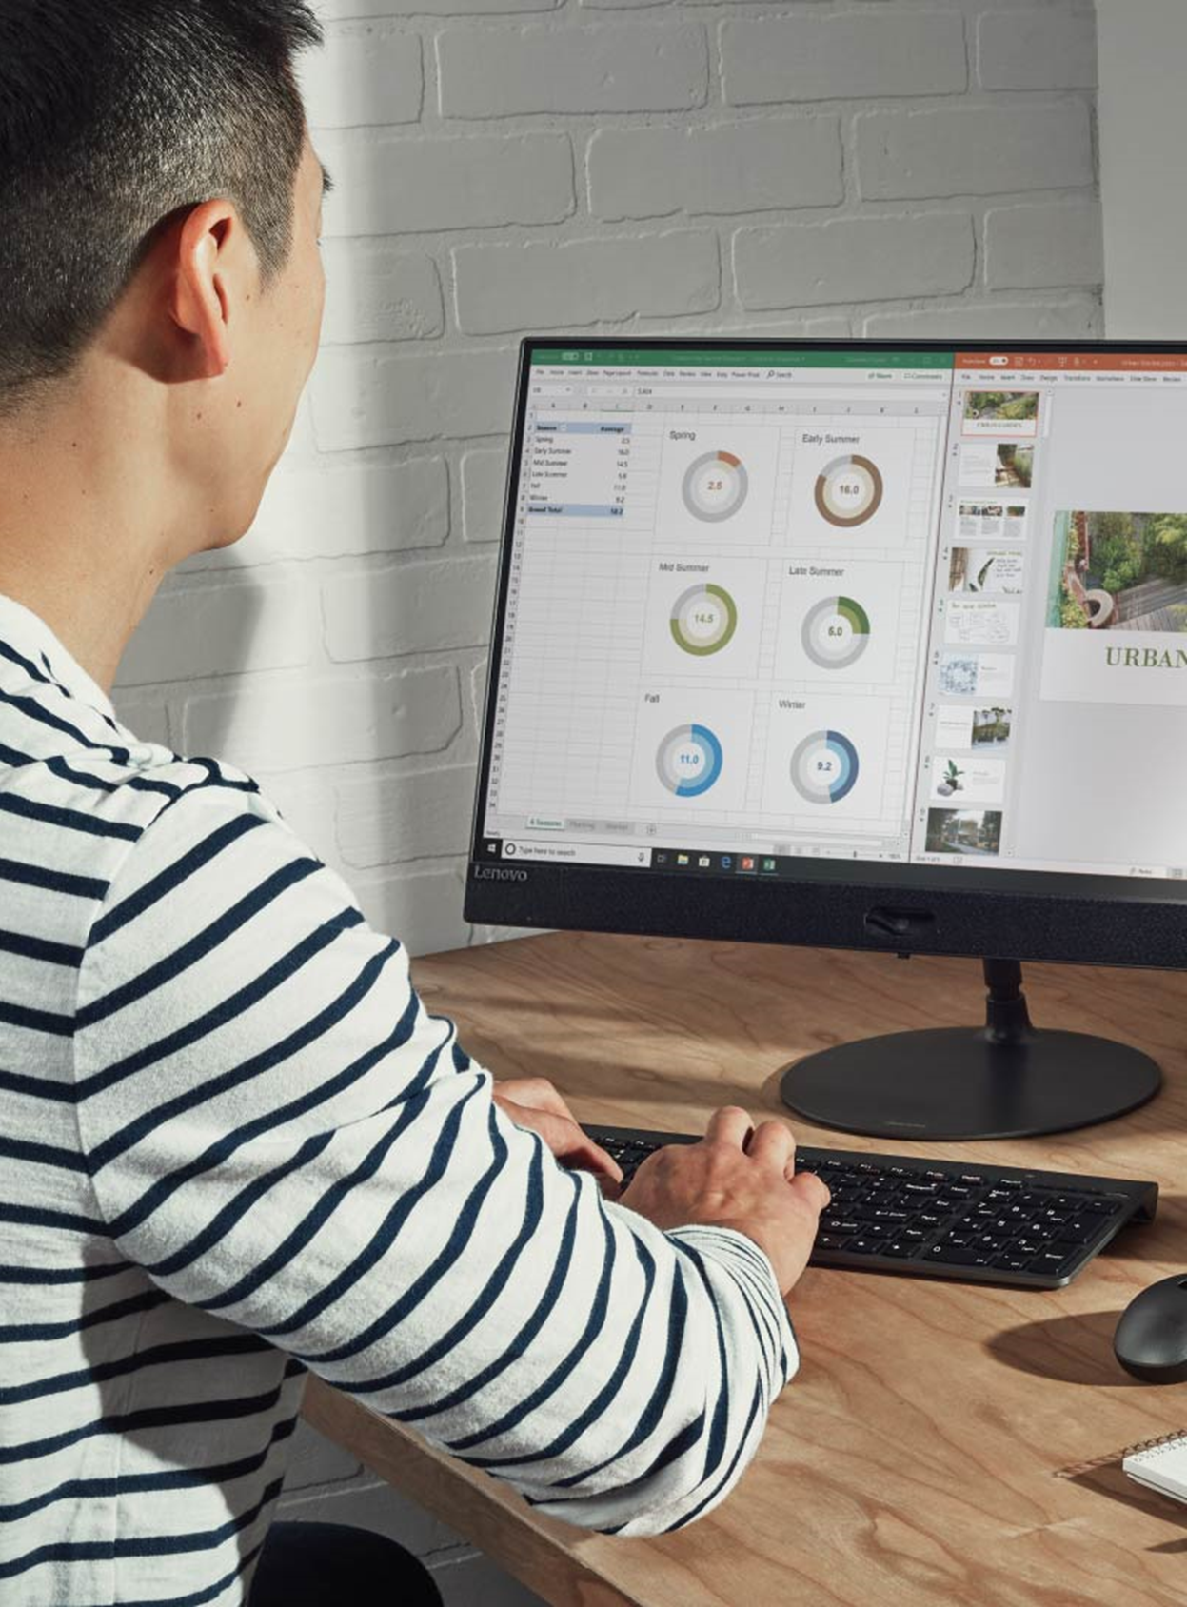
Add data to presentations
Add an Excel chart
Include a table
Create a flowchart

Slide 54
Accessible Presentation Tools

Slide 55

In this lesson:
Making presentations accessible

Slide 56
Accessibility Checker
Reviews documents and suggests how to address visual issues

Slide 57
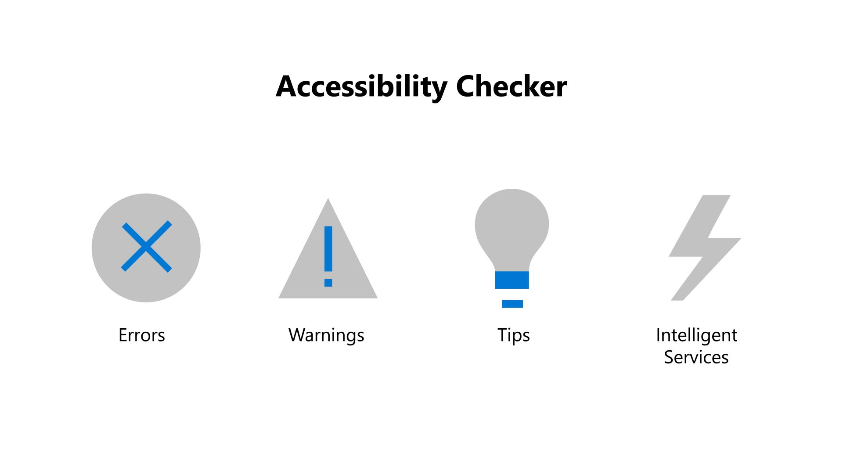
Accessibility Checker
Errors
Warnings
Tips
Intelligent Services

Slide 58
Errors
Elements that may be difficult for someone to use

Slide 59
Warnings
Identify content that could be difficult for users to understand

Slide 60
Tips
Identify content that could be presented or described more effectively

Slide 61
Intelligent Services
Automatically generates alternative text to accurately describe images and graphics

Slide 62
Alternative Text
Descriptive text which conveys the meaning and context of a visual item

Slide 63
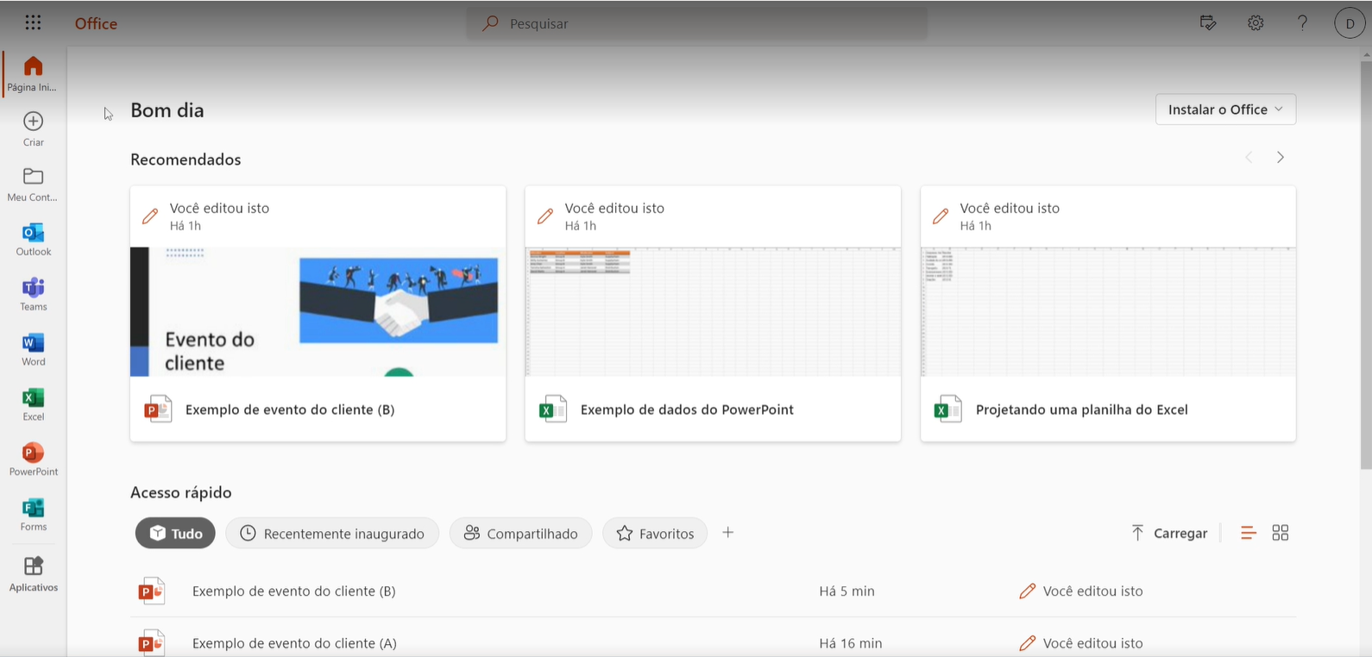
Exercise Files > Customer Event Example (B).pptx

Slide 64
Subtitles
Ensure that everyone can follow along with the speaker’s words during a presentation

Slide 65

Improve accessibility
Use the accessibility checker
Add alternative text
Add subtitles

Slide 66
Delivering Presentations

Slide 67
In this lesson:
Sharing and adding speaker notes to a presentations

Slide 68
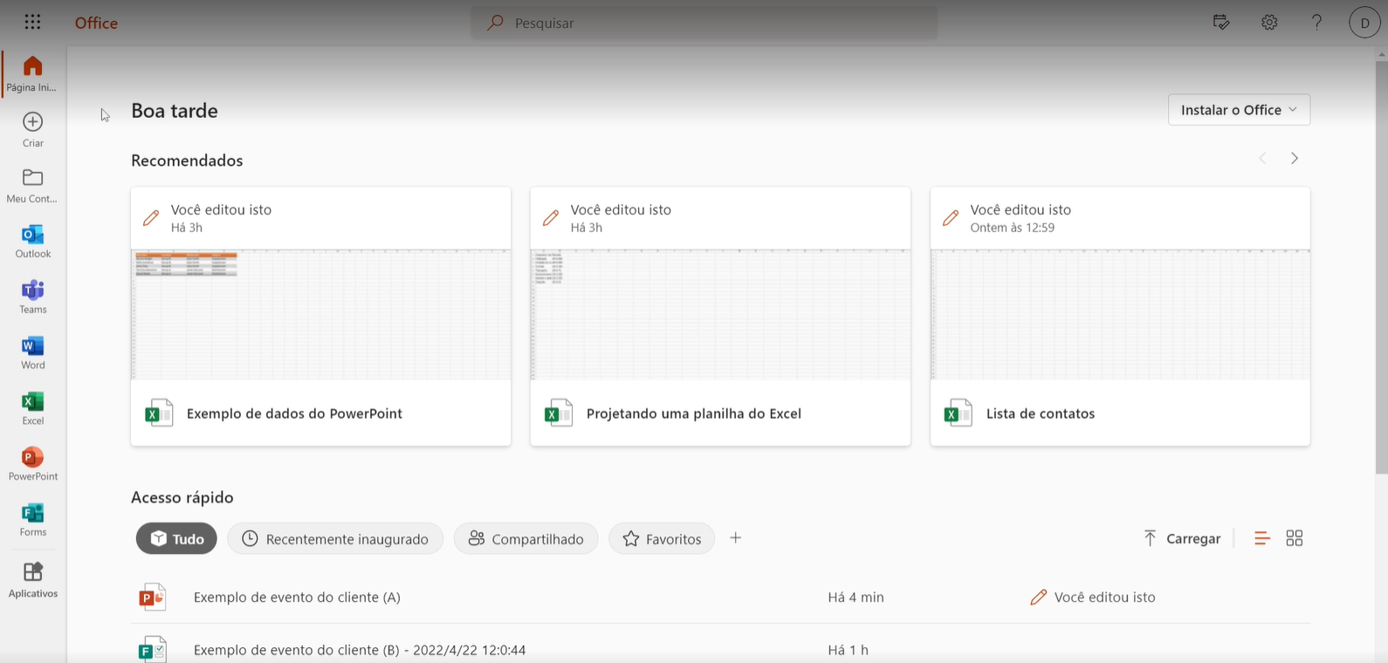
Exercise Files > Customer Event Example (A).pptx

Slide 69
Deliver your presentations
Add speaker notes
Share your work

Slide 70
Presentation Best Practices

Slide 71
In this lesson:
Following presentation best practices

Slide 72
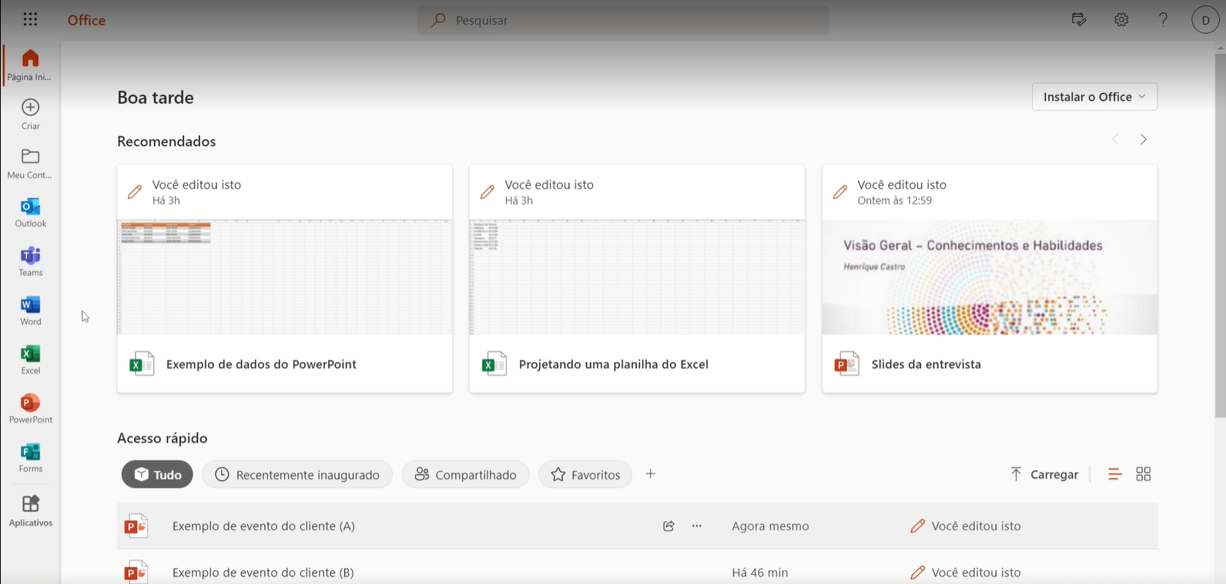
Exercise Files > Customer Event Example (A).pptx

Slide 73
Improve your presentations
Adjust font style and size
Abbreviate text
Add media
Check accessibility

Slide 74
Formatting Your Documents

Slide 75
In this lesson:
Formatting documents

Slide 76
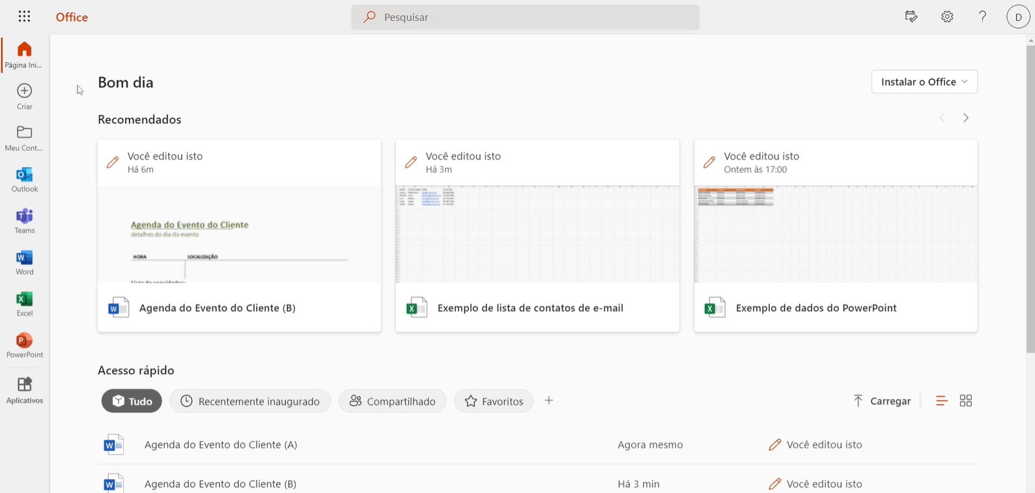
Exercise Files > Customer Event Itinerary Example (A).docx

Slide 77
Improve your documents
Add pictures
Add headers and footers
Insert page breaks

Slide 78
Adding Tables

Slide 79

In this lesson:
Creating and editing tables

Slide 80
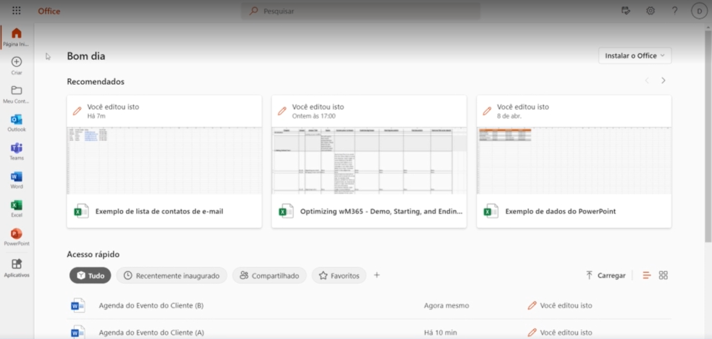
Exercise Files > Customer Event Itinerary Example (B).docx

Slide 81
Create your own tables
Insert basic table
Adjust table formatting
Check table accessibility

Slide 82
Creating and Modifying References

Slide 83
In this lesson:
Adding citations and outlines to documents

Slide 84
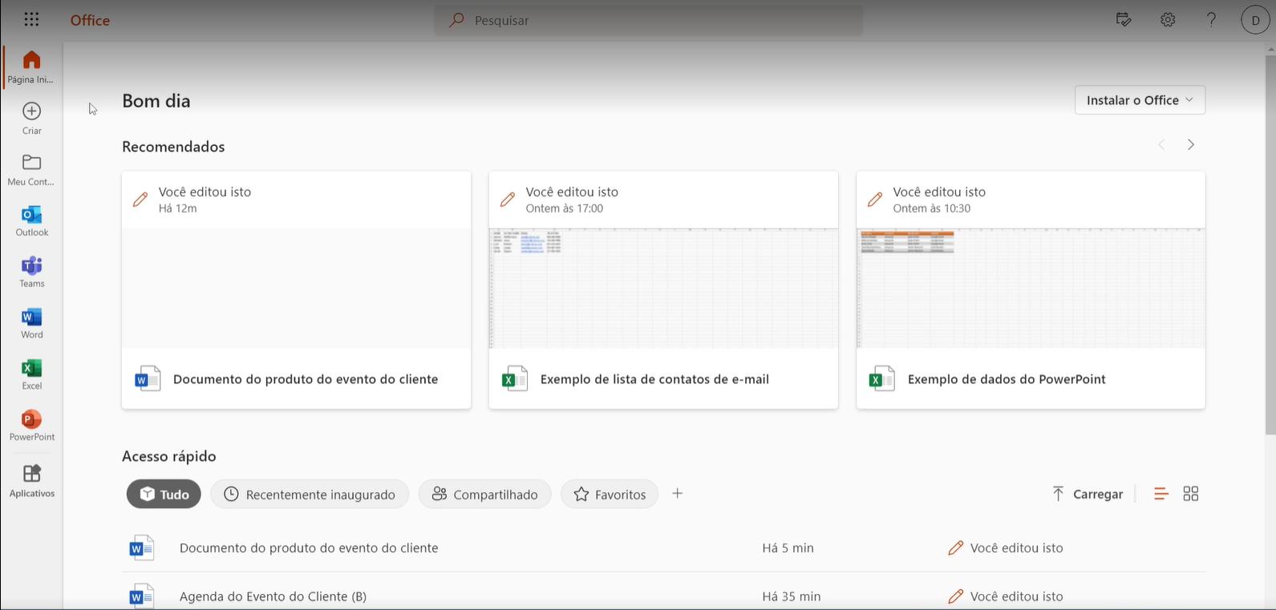
Exercise Files > Customer Event Product Document.docx

Slide 85
Footnotes
Citations at the bottom of a page
Citation number added after text

Slide 86
Table of Contents
Built from text headers
Add subheadings
Select location and insert

Slide 87
Elevate your documents
Add references as footnotes
Add a table of contents

Slide 88
Document Review

Slide 89

In this lesson:
Collaborating on documents

Slide 90
Exercise Files > Document Review.docx

Slide 91
Update your documents
Check spelling and accessibility
Track and accept changes
Add and review comments

Slide 92
Settings and Permissions

Slide 93

In this lesson:
Managing settings and permissions

Slide 94
Manage team access
Modify settings
Review permissions

Slide 95
Managing Your Call Settings

Slide 96

In this lesson:
Managing call settings

Slide 97
Update your call settings
Set up call forwarding
Configure your voicemail
Customize out-of-office greeting

Slide 98
Working with External Guests

Slide 99
In this lesson:
Inviting and managing external guests

Slide 100
Add guests to your team
Invite guests
Manage settings

Slide 101
Hosting Large Meetings

Slide 102
In this lesson:
Adjusting your settings for large meetings

Slide 103
Some meeting organizer features available only on desktop

Slide 104
Host efficient meetings
Adjust meeting settings
Specific presenter access

Slide 105
Presenting to Large Meetings in Teams

Slide 106
In this lesson:
Presenting tools in Teams

Slide 107

Share content with Teams
Share a PowerPoint
Share a window in a meeting

Slide 108
Using Breakout Rooms

Slide 109
In this lesson:
Creating and managing breakout rooms

Slide 110
Breakout room management available only on desktop

Slide 111
Breakout Room organization
Managers
Names
Time limits
Close

Slide 112
Create Breakout Rooms
05_06 Row X
Needed here
Assign a manager
Set time limits

Slide 113
Using Mail Merge

Slide 114
Mail Merge
Individualized messages
Auto-fill information

Slide 115
In this lesson:
Understanding mail merge

Slide 116
The Mail Merge process
1
Build the document
2
Insert merge fields
3
Word generates personalized documents

Slide 117
Mail Merge process
Only available on desktop
Works with Outlook and Excel desktop
Consider updating your Microsoft 365 account

Slide 118
Prepare a Mail Merge
Gather recipient data
Draft your content

Slide 119
Completing a Mail Merge

Slide 120

In this lesson:
Sending a Mail Merge

Slide 121
Mail Merge

Slide 122
Mail merge wizard available only on desktop on Windows

Slide 123
Exercise Files > Practice Mail Merge Document.docx

Slide 124
Complete a Mail Merge
Add recipients
Add fields
Send

Slide 125
Creating Envelopes and Labels

Slide 126
In this lesson:
Creating a mail merge and generating labels

Slide 127
Mail merge available on desktop only

Slide 128
Exercise Files > Example_Contact_List.xlsx

Slide 129
Create a Mail Merge
Start a mail merge
Use the mail merge wizard
Print labels or envelopes

Slide 130
Optimizing Your Work with Microsoft 365

Slide 131
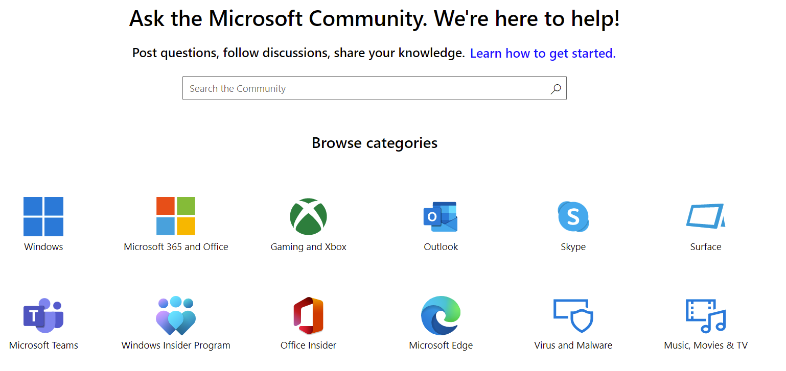
https://answers.Microsoft.com/en-us

Slide 132
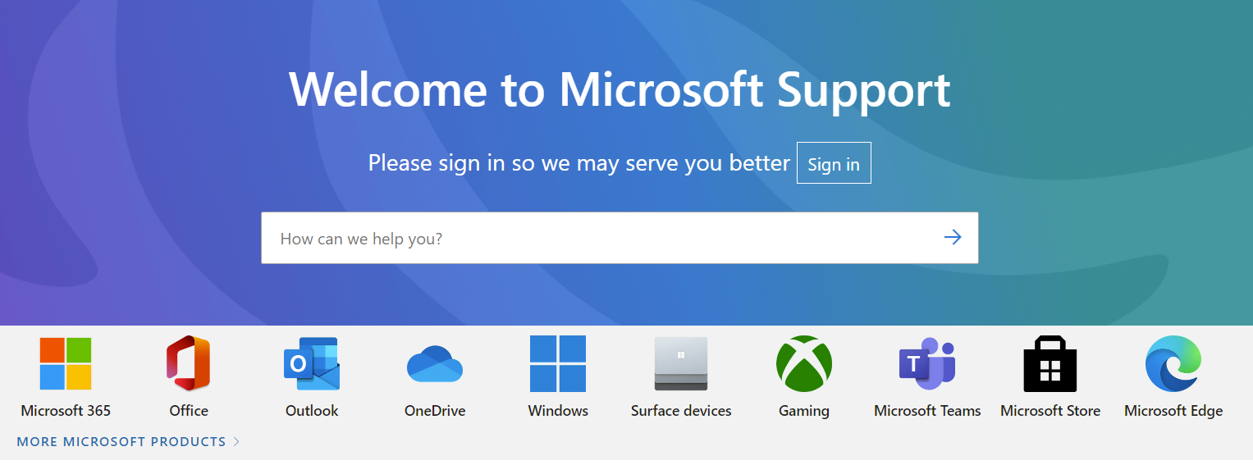
https://support.microsoft.com

Slide 133
Optimizing Your Work with Microsoft 365

